Slide 1
Removable Partial dentures
Common errors in the practice of general dentistry
Linda J. Thornton DDS, MS, FACP

Slide 2
Removeable Partial Dentures
Presentation
“What if” Scenarios/Discussion Period
Dentistry in Action (Video)
Interactive Feedback/Discussion

Slide 3
BASIC PROCEDURES
Treatment planning:
Oral exam
Radiographs
Preliminary Impressions
Surveying
RPD design
Developing the “blueprint”
2. Patient Communication
3. Tooth Preparation
4. Final Impression
5. Laboratory Communication (metal framework)
6. Framework Try-in
7. Denture Occlusion
8. Laboratory Communication (denture processing)
9. Denture Try-in
10.Post-insertion Treatment

Slide 4
Treatment Planning—?????????????
What do I do first?
What are my treatment options?
How do I do It?
“Work with what you have”
Common Errors:
Failure to determine if the patient is a candidate for RPD therapy.
Focusing exclusively on implant replacement therapy
NOTE: Implants are A treatment modality not THE treatment modality

Slide 5
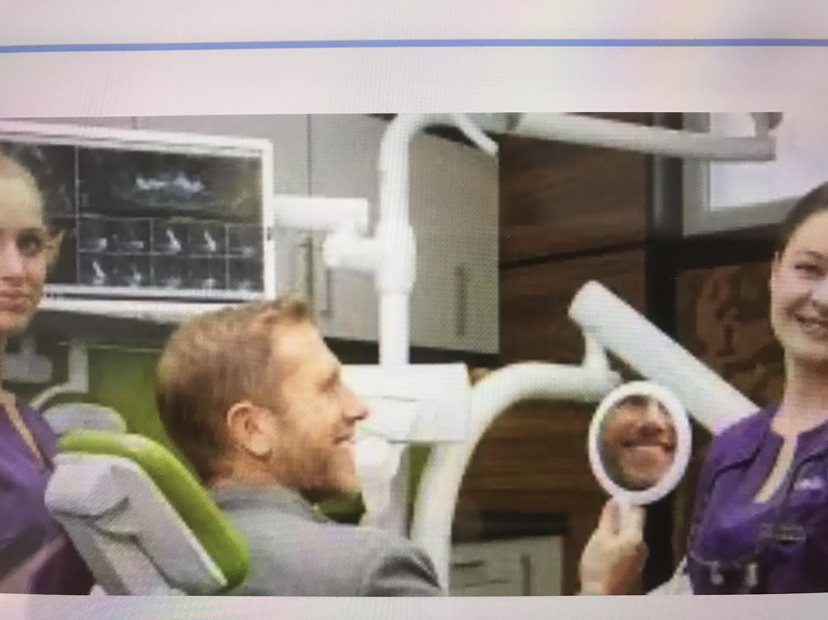
Understanding the Edentulous Predicament Developing Patient Rapport
Listen to your patient
Review Medical History
FMX/Panorex
Good and bad about existing dentures
Examine oral structures
Give a prognosis (to include possible problem areas BEFORE you start)
Ask for photos of patient before teeth were extracted
Ask for family input during treatment
Make alginate impressions of dentures that they like wearing

Slide 6
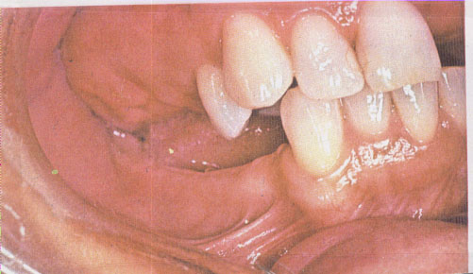
Treatment Planning—Oral Exam
Tooth supported RPD
RR does not aid in support
Teeth absorb occlusal load
Ridge supported RPD
As distance from distal abutment increases, support by RR increases
RR absorbs occlusal load

Slide 7
Treatment Planning—Oral Exam
Maxillary Ridge:
Crest of the RR
Primary stress-bearing area
Buccal/lingual slopes
Counteracts horizontal force

Slide 8
Treatment Planning—Oral Exam
Mandibular Ridge:
Crest cannot support occlusal load
Buccal shelf--- primary stress-bearing area (vertical forces)
Slopes of the ridge---primary stress-bearing area (horizontal forces)
Retromolar pad remains constant throughout life and MUST be covered by the denture base….WHY?

Slide 9
Treatment Planning—Oral Exam
Retromolar pad remains constant throughout life and must be covered by the denture base
Previous denture did not cover retromolar pad

Slide 10
Treatment Planning—Radiographs
Bitewings and PA’s are Critical
Panorex ---limited information
Occlusal Analysis (often times NOT done)
Patient involvement/informed consent

Slide 11
Treatment Planning—Preliminary Impressions
Irreversible hydrocolloid (alginate)
Plastic or Metal perforated trays
Common Errors:
Width of the impression tray is insufficient to cover the RR
Solution: Use metal perforated trays
Widen the tray with pliers
Under-extended tray
Solution: Proper positioning of patient
Upright versus Horizontal access

Slide 12
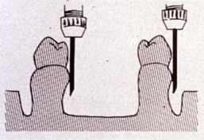
Treatment Planning--Surveying
Objective:
To locate and evaluate tooth and soft tissue undercuts
Rationale:
To select a POI that encounters the least amount of tooth/tissue interference with balanced retention

Slide 13
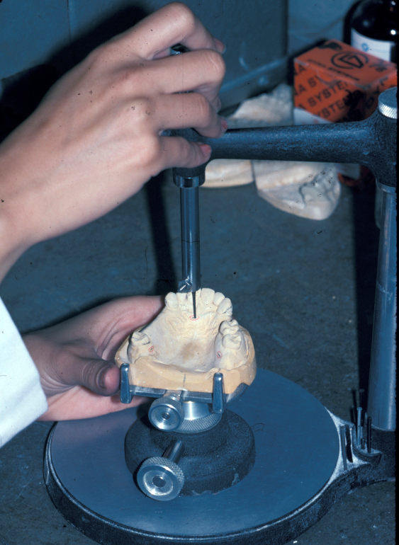
Treatment Planning--Surveying Common Errors
Most students and general dentists don’t like to use them “Eyeballing” is Not an option

Slide 14
Treatment Planning—Developing the “blue print”
Final product of treatment planning
Reference to be used chair-side
Common Error:
Most students and general dentists do not use the blue print as a guide during tooth preparation

Slide 15
Treatment Planning—RPD Design
60% understanding the basic principles
40% assessing the case and applying the basic principles
Common Errors:
Failure to THINK about what you need BEFORE you develop the design
Kennedy Classification
Biomechanics
Where is the fulcrum line? (movement)
Balanced retention on both sides of the arch

Slide 16
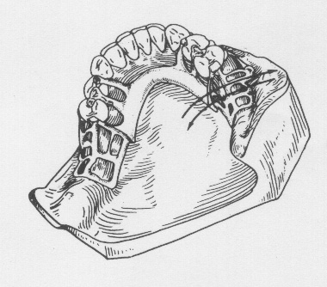
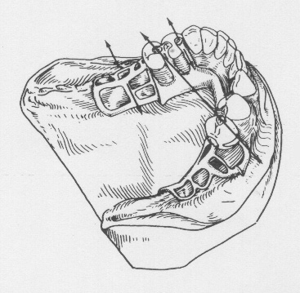
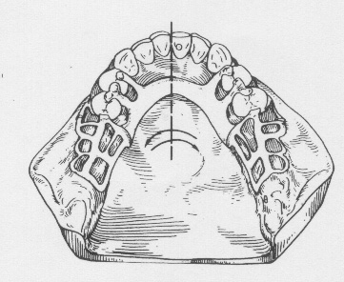
TREATMENT PLANNING—RPD Design BIOMECHANICS—CENTERs OF ROTATION FOR METAL FRAMEWORK
Knowledge of the affects of movement due to location of fulcrum line, longitudinal and vertical axes.

Slide 17
Class Discussion
Name the Kennedy classification?
If the diagonal line (in illustration) represents the fulcrum line,
where is the indirect retainer?

Slide 18
Class Discussion
Name the Kennedy classification?
Find the fulcrum line
How many indirect retainers?

Slide 19
Class discussion
Name the Kennedy classification?
How many direct retainers?

Slide 20
Class Discussion
Name the Kennedy classification?
How many indirect retainers?

Slide 21
Use “Blueprint” Chair-side
COMMON ERRORS:
Explain to the patient the tooth preparation required
Local anesthetic may/may not be indicated
Tooth preparation with WITH water
Drilling should be intermittent (unlike crown and bridge tooth preparation)

Slide 22
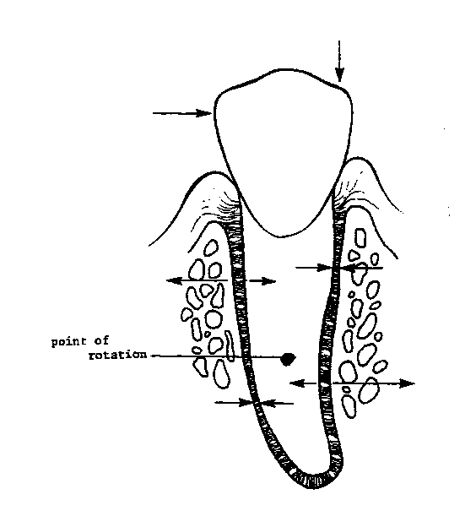
Tooth Preparation—Remember Biomechanics---center of rotation for abutment tooth

Slide 23
Tooth Preparation---Guide plane
Common Errors:
Develop Guide plane FIRST not the rest seat
Use multi-fluted finishing burs
Rationale:
Minimal enamel removal
Leaves a polished surface
Much better than diamond bur

Slide 24
Tooth Preparation---Where should I place the guide plane?
Next to edentulous area
Width depends upon size of tooth

Slide 25
Why do I Need Rest Seat Preparations?
Must be prepared on abutment teeth requiring a metal rest

Slide 26
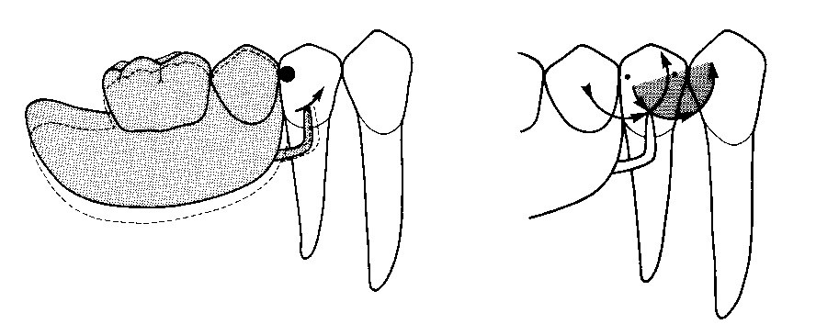
Treatment Planning—RPD Design Where should I place the rest seat?
Distal Rest Seat
Mesial Rest Seat

Slide 27
Treatment Planning—Tooth Preparation
Use #6 followed by #8 round bur (high speed—intermittent drilling)
½ the depth of the bur
Divergent axial walls
Deep portion ONLY in center (remaining portion of preparation is 1-1.5mm)
Common error: insufficient tooth preparation

Slide 28
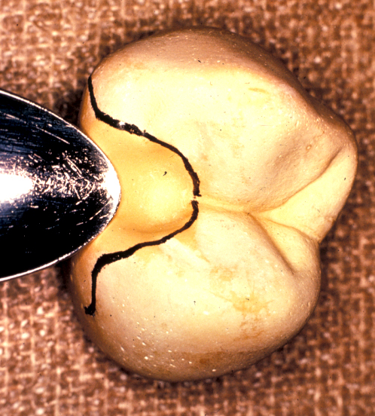
Treatment Planning—RPD Design What type of rest seat should I use?
Occlusal
Cingulum vs Straight Ledge
Incisal (not used that often)

Slide 29
Treatment Planning— RPD design Occlusal Rest Seat
Ideal tooth preparation:
Spoon-shaped
Inclined <90 degrees apically from the marginal ridge
½ BL width, 1/3 MD width
Divergent axial walls--no undercuts
2.5mm depth
Solution: Red rope wax

Slide 30
Treatment Planning—RPD Design Embrasure Rest Seats
Ideal tooth preparation:
Extends over the occlusal surfaces of 2 approximating teeth
Extension to include buccal and lingual surfaces
Must have thru and thru clearance of at least 3mm clearance in centric and eccentric movements
Solution: Use the periodontal probe

Slide 31
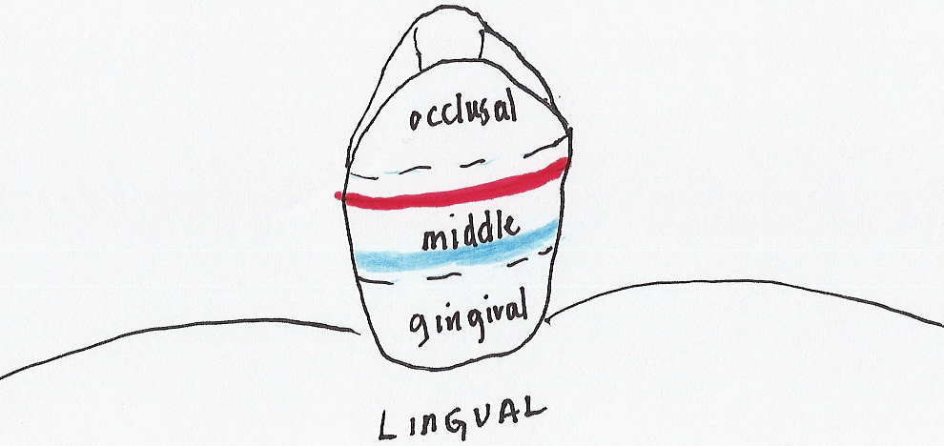
Tooth Preparation—Remember Biomechanics---center of rotation for abutment tooth----clasp, bracing Arms

Slide 32
Treatment Planning—RPD Design What type of clasp assembly should I use?
Circumferential
Cobalt-chromium/Akers (.01-.02”)
Wrought wire (.01” or >)
“I” bar (.01 inch only)
Selection is based upon: tooth size, undercut obtained, periodontal status (present and future), esthetics
T” bar
Modified “T”bar
Back action
Ring
Bottom line:
Can you justify your selection?
The clasp is NOT the only source of retention

Slide 33
Final Impression
Irreversible hydrocolloid (alginate)
Vinyl Poly-siloxane
Polysulfide (rubber base)

Slide 34
Final Impression—Common Errors
Inspection:
Insure that material has not pulled away from the tray
Voids
Metal tray show through

Slide 35
Quality of the Master Cast—Common Errors
Voids and bubbles
Grinding sludge left by the cast trimmer.
Cast does not capture denture support areas
Retromolar pad
Maxillary tuberosity

Slide 36
Quality of the Master Cast—Common Errors
The peripheral roll should be approx. 3-4mm. deep.
The base should be not less than 15mm. thick at the thinnest area (lingual region on mand. cast)

Slide 37
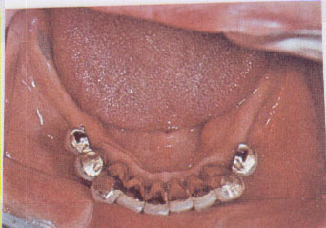
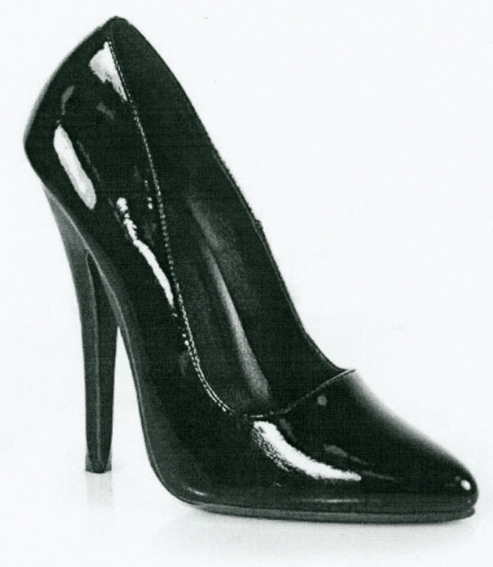
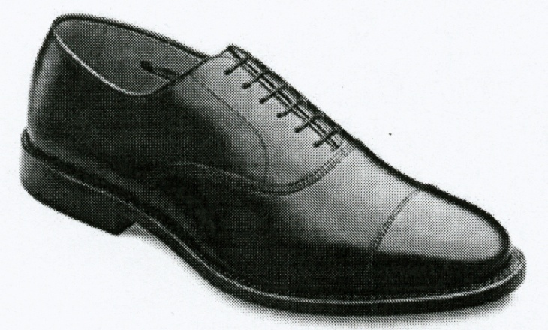
Quality of the Master Cast—Insufficient Vestibule Depth------Bone Loss

Slide 38
Troubleshooting----problems assoc. with making/pouring impressions
Problem: Surface of cast is soft and chalky
Probable cause: saliva in impression, improper water to powder ratio
Solution: soak in slurry mix before pouring impression, remove cast within one hour of initial pour, use recommended water to powder ratio
Problem: cast is weak and teeth are easily broken
Probable cause: incorrect water to powder ratio
Solution: follow manufacturers’ recommendations for water to powder ratio

Slide 39
Troubleshooting----problems assoc. with making/pouring impression
Problem: voids and/or nodules in rest seat areas
Probable cause: failure to place alginate on teeth before seating the tray
Solution: wipe alginate onto the teeth and vestibules to reduce air entrapment and resultant voids and nodules on the cast
Problem: Depth of impression borders is insufficient
Probable cause: Failure to border mold tray prior to making impression
Solution: Use rope wax around periphery of tray

Slide 40
Laboratory Communication—Authorization Form
Narrative:
Concise and to the point (“KISS” principle)
Legible
Illustration:
Diagram should correspond with narrative
Color codes
Eliminates confusion
(Unless specified) are not required

Slide 41
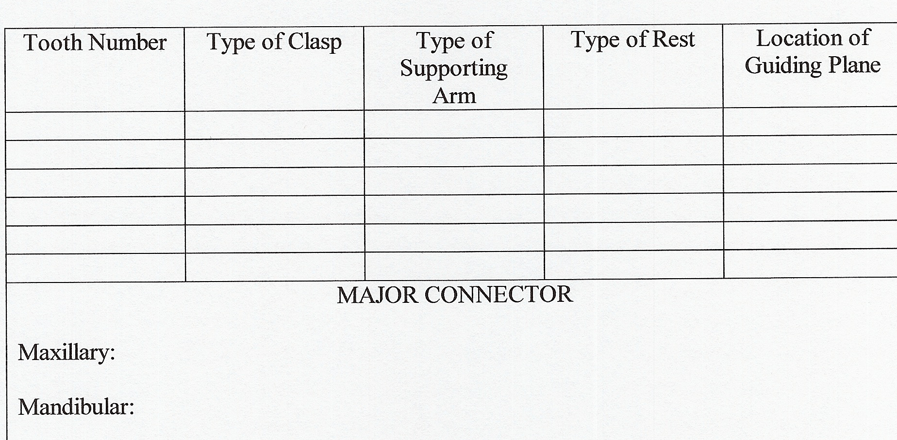
Type of major connector
Location/description of metal components
Tooth number
Rest
Clasp/Retention
Bracing arm
Guide plate
Tooth modification**
Thank you
Keep it SHORT and to the point. You are not writing a novella.

Slide 42
Metal Framework try-in
Inspect the metal framework
Completed design=requested design
Rest seats are covered
Clasp assembly is in contact with abutment teeth
A framework fits the cast, may not necessarily fit in the mouth

Slide 43
Metal Framework Adjustment
Check contact of the metal on the teeth
If framework does not fit
Rouge/chloroform mixture
Occlude
Detects interferences

Slide 44
Metal Framework Adjustment
Paint mixture on intaglio surface
Air dry
Insert framework

Slide 45
Metal Framework Adjustment
Air dry
Inspect metal framework for show through areas

Slide 46
Metal Framework Adjustment
Fissure bur or inverted cone
High-speed handpiece
Most common area of interference:
Junction of guide plate/rest
Check retentive quality of clasp arm (do not bend the clasp to increase retention)
Check the occlusion—maximum intercuspation (centric occlusion) ONE framework at a time

Slide 47
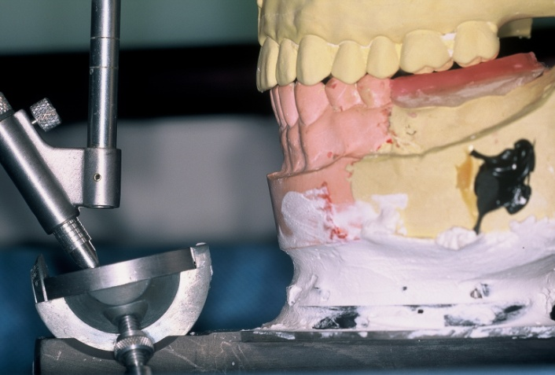
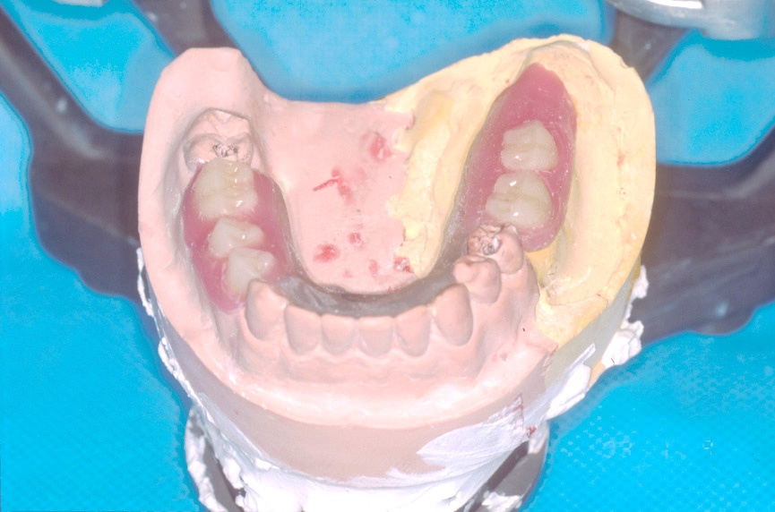
Denture Occlusion--Denture Set-up
Make occlusal wax rim
CJR record
Tooth set-up
Confirm centric chair-side before sending to laboratory
Alternative Method:
Laboratory sets teeth and returns to dentist for wax try-in

Slide 48
Partial Denture Try-in
Similar to complete denture try-in
Pressure indicating paste (PIP)
Thinly coat the intaglio surface of the denture flange
Insert denture until seated
Remove denture and check for rubbed away areas
Adjust denture base until fully seated
Check for over-extended denture flange
Relieve muscle attachment areas
Check the following positions:
Centric
Lateral
Protrusive
Each position must be performed separately
NOTE: Similar procedure for metal framework try-in

Slide 49
Post Treatment Therapy
Denture Home Care and Maintenance (safe method for removal and insertion)
Patient returns in 24-48 hours
Check the following:
Denture Borders
Occlusion
Sore spots
Depending on patient’s experience with RPD’s, post treatment could last for several months

Slide 50
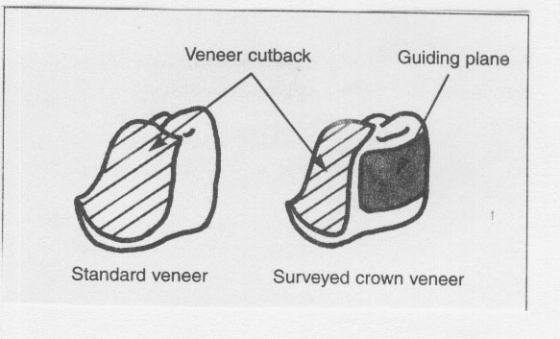
“What if “scenario #1---Surveyed Crown
Ideal tooth preparation
Additional tooth reduction for:
Guide plate
Rest seat
Insufficient tooth reduction
Rest seat perforation
Increased crown width
NOTE: Surveyed crowns do not have the same contours as a traditional crown

Slide 51
“What if” Scenario #2—Surveyed Crowns to fit existing denture
58-year old man
Has an existing RPD one-year old
Defective resin veneered restorations
Tooth #s 27, 28
NEW DENTURE?????

Slide 52
Defective restorations removed
If possible, use reline defective restorations and use as provisional restorations

Slide 53
Teeth were prepared for PFM restorations
VPS syringed into gingival sulcus
RPD is inserted and inspected for complete seating

Slide 54
Pick-up impression is inspected for accuracy
Yellow area is intaglio surface
Before pouring, retentive arms and resin undercuts are blocked out with wax (ensure removal of RPD)
Disadvantage: Patient temporarily surrenders RPD

Slide 55
Final restoration is fabricated using the RPD on the working cast

Slide 56
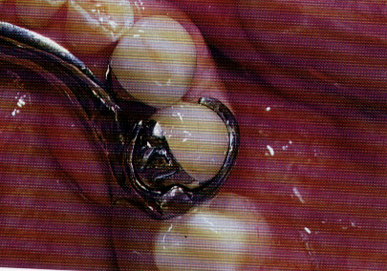
Completed crowns are tried in adjusted and cemented

Slide 57
Dentistry in Action (video)
What happens if the metal framework fits in the mouth BUT the master cast is broken or chipped on the distal extension portion of the residual ridge and you can’t re-assemble the pieces?
Remake the metal framework? Yes or No

Slide 58
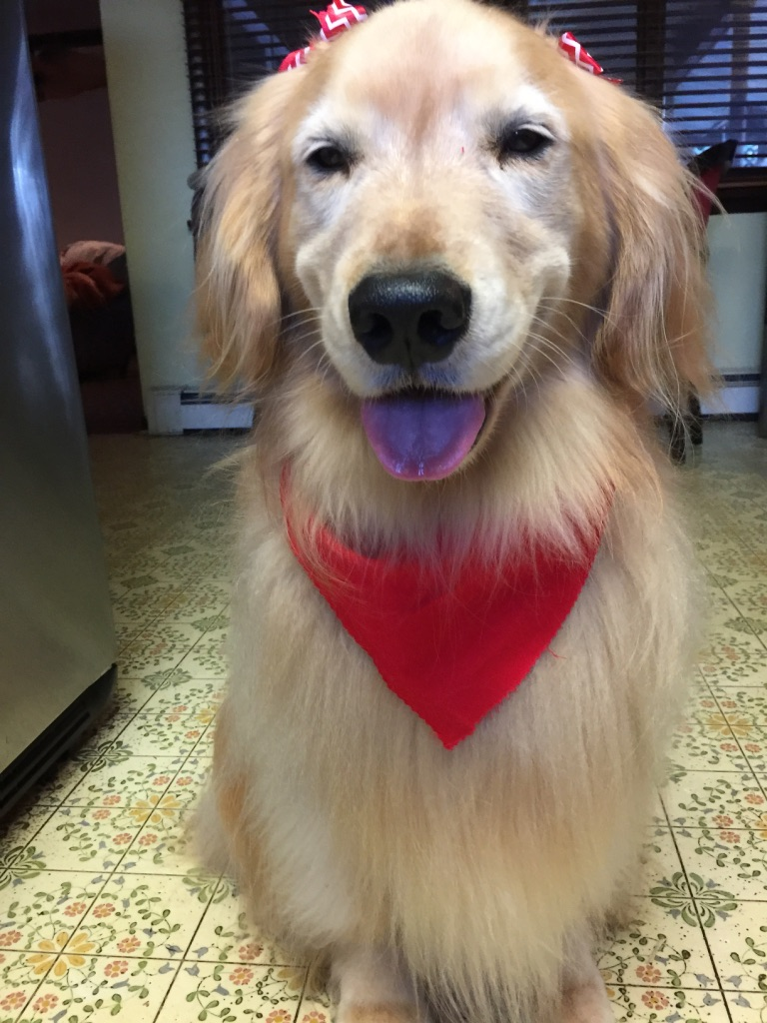
Ok, it’s time for the movie
ENJOY!!!
Please use Videos from:
VTS-01-1 VOB—Altered Cast
VTS-01-2 VOB—Framework Try-in

